Slide 1
PowerShell for the DBA: Why I love my inner pig-dog
William Durkin

Slide 2

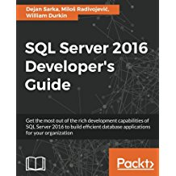



Who am I?
William Durkin
Data Platform Architect @ datamasterminds.io
10+ Years with SQL Server
DBA / System Architect
Data Platform MVP (March 2017)
williamdurkin.com
@sql_williamd
williamdurkin@datamasterminds.io

Slide 3
“I will always choose a lazy person to do a difficult job because a lazy person will find an easy way to do it”
-Bill Gates

Slide 4

http://dbatools.io

Slide 5
DBAReports
Standardized Reports for DBAs
http://dbareports.io

Slide 6
Ola Hallengren
One-stop script library
Backup & Maintenance
http://ola.hallengren.com

Slide 7
Query Store without SQL 2016
Alpha-version: 2008R2+
Target: 2005 - 2014
http://openquerystore.com

